Slide 1
DAV-R WS2024Graduation Project by: Reem Assad El-Meghalawy Bachelor of Veterinary Medicine- Food Safety & Hygiene Diploma in Animal Microbiology and Immunology Mansoura University
Wrangling of Antibiotic Resistance Microbiology Dataset for Analysis of Klebsiella Pneumoniae Trends

Slide 2
Abstract
Antimicrobial resistance continues to increase while the pipeline for new antibiotic development is drying up; after only eight decades of antibiotic use, bacterial infections that once were easily treated are becoming untreatable. Antimicrobials have enabled the advancement of many areas of medical practice. The successful outcomes of many surgical procedures and immunosuppressive treatments depend on antibiotic prophylaxis and the ability to treat infectious complications. Antibiotic resistance correlates with antibiotic use, so improved antimicrobial stewardship, with better prevention and diagnosis of infection, can help to conserve the currently available antimicrobial agents. Significant global action and investment, from both public and private sector funding, is required if the development of new anti-infectives is to keep pace with increasing resistance.

Slide 3
Pipeline Structure
Data source and Acquisition.
Data Wrangling (cleaning & Preprocessing)
Exploratory Data Analysis (EDA)
Statistical Analysis
Visualization & Reporting

Slide 4
Data source and Acquisition
The Antibiotic Resistance Microbiology Dataset (ARMD) is a de-identified resource derived from electronic health records (EHR) that facilitates research into antimicrobial resistance (AMR). It provides a comprehensive overview of microbiological cultures, including urine, respiratory, and blood cultures. This dataset includes 283,715 unique adult patients and features detailed information on culture results, identified organisms, antibiotic susceptibility, and associated demographics and clinical data. The dataset was meticulously constructed through a multi-step process designed to enhance data quality and relevance. Key attributes include organism identification, susceptibility patterns for 55 antibiotics, implied susceptibility rules, and de-identified patient information. This dataset supports studies on antimicrobial stewardship, causal inference, and clinical decision-making. The dataset integrates microbiology laboratory results, demographic data, clinical encounters, antibiotic exposures, and socioeconomic indicators to comprehensively analyze AMR patterns.
Published Jan 23, 2025; Updated Apr 11, 2025 on Dryad.

Slide 5
Data Wrangling (cleaning & Preprocessing)
Initial exploration for missing values and data summarization.
Handling missing data: Empty cells in the dataset are represented as “null” to ensure clarity.
Standardization.
Filtering & Subsetting: selecting data of interest and merging between datasets using a common key column.

Slide 6
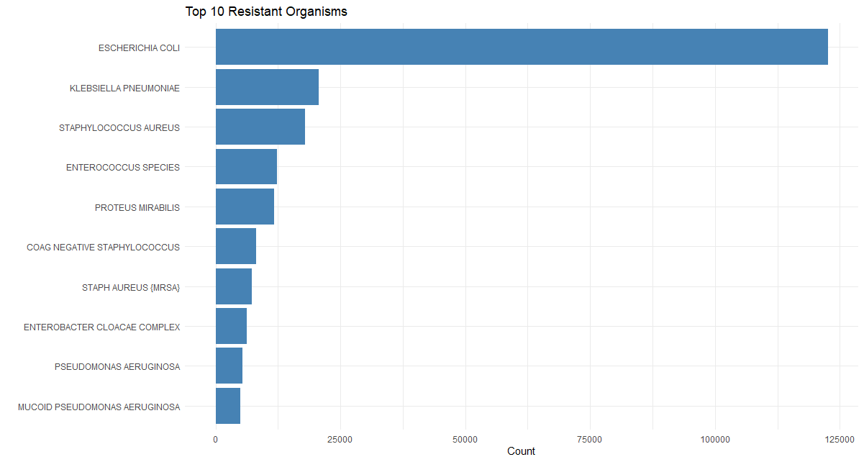
Exploratory Data Analysis Distribution shows the top ten most frequently isolated microorganisms
As shown, Klebsiella pneumoniae is the second most resistant microorganism to antibiotics. The danger comes from it being the second most common cause (behind Escherichia coli) of community- and hospital-acquired Gram-negative bloodstream infection, which is called nosocomial infection.K. pneumoniae bloodstream infections usually arise as a complication of focal urinary, gastrointestinal, or respiratory tract infections. However, occasionally they can arise without a definable source.

Slide 7
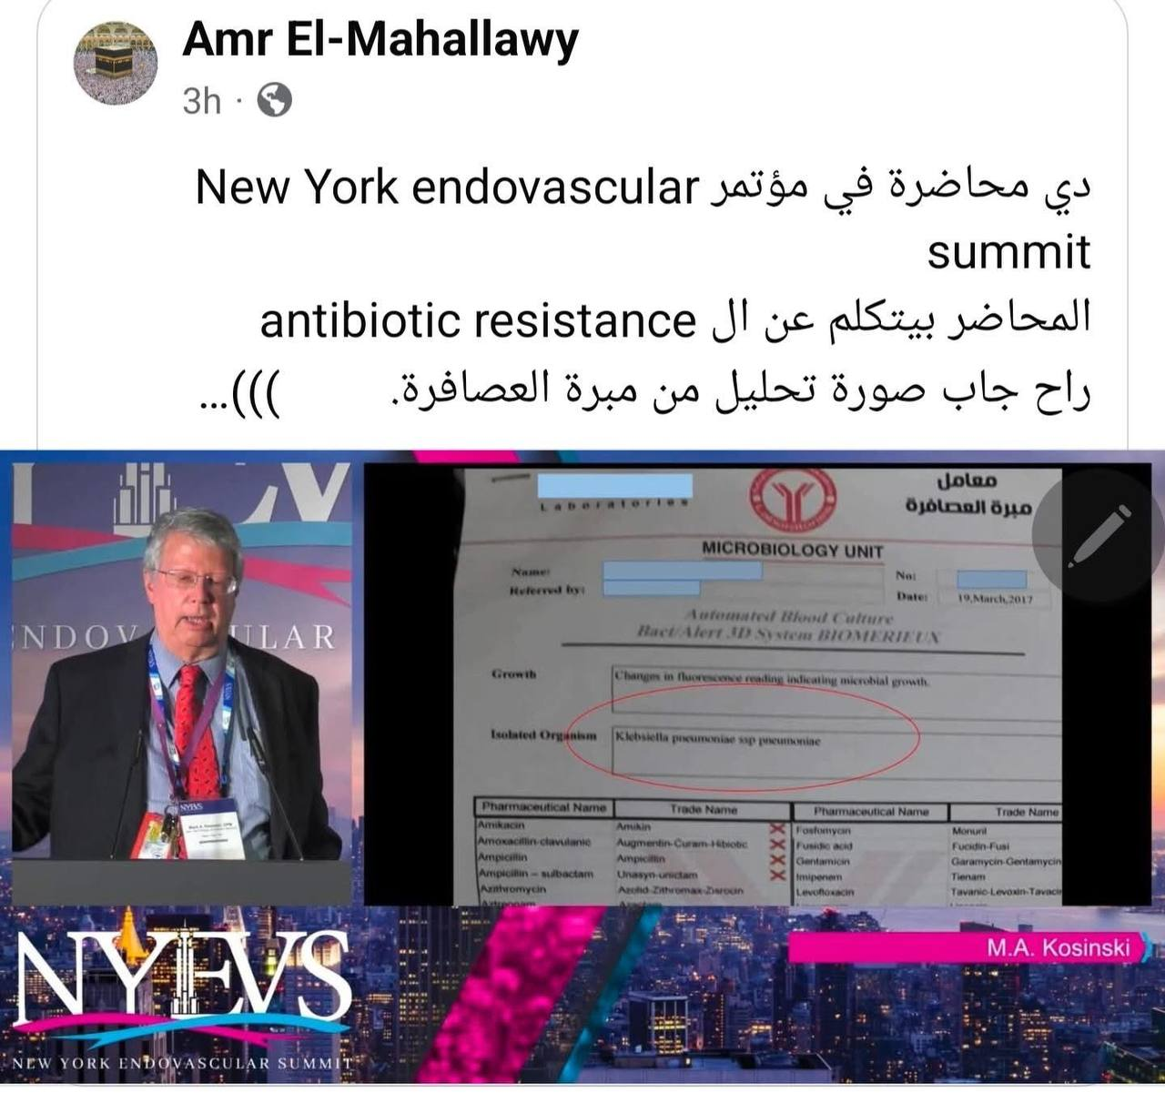
here's a picture from the New York Endovascular Summit, back in December 2024 lecture: Interpretation of a C&S Report by Dr. Mark A Kosinski
A culture and sensitivity report from a Biochemical lab in Egypt, back to 2017.
The isolated organism is Klebsiella Pneumoniae, shown here resistant to all kinds of antibiotics, except colistin, which is nephrotoxic.

Slide 8
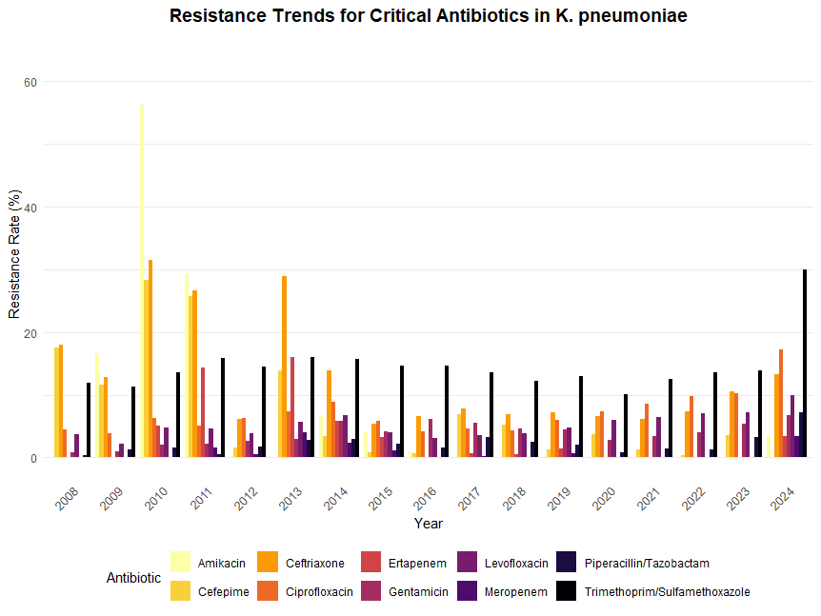

Slide 9
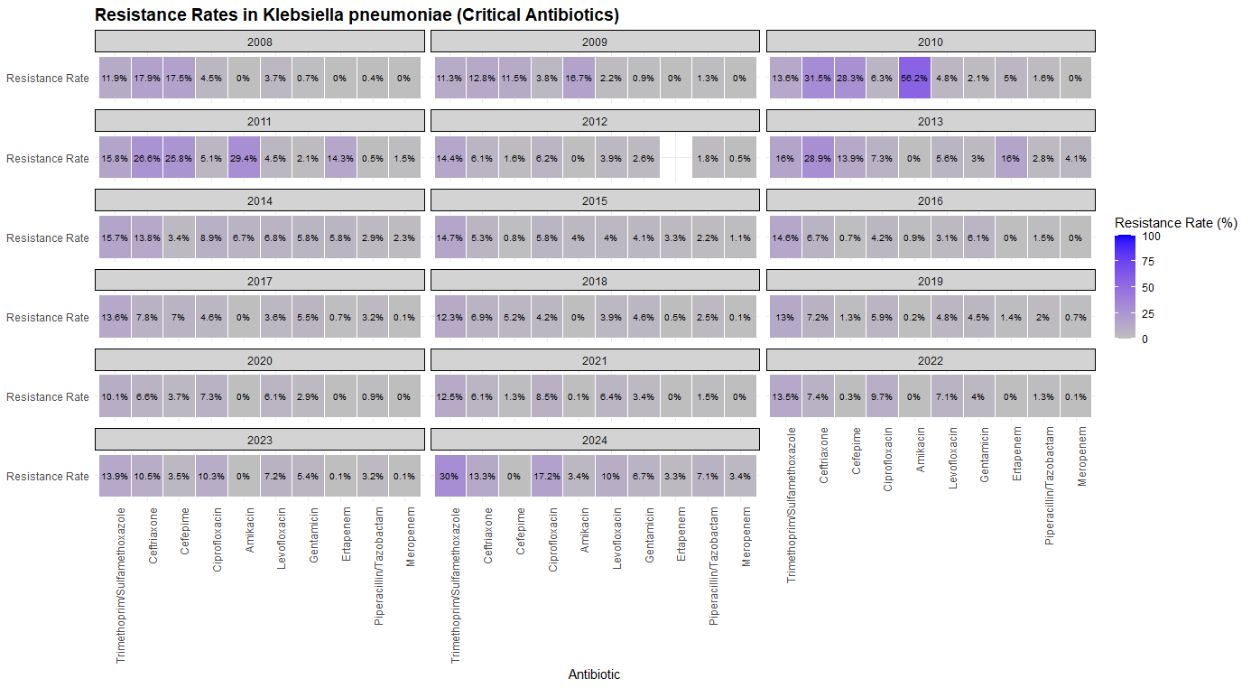
Temporal Trends in Klebsiella Pneumoniae resistance rate

Slide 10
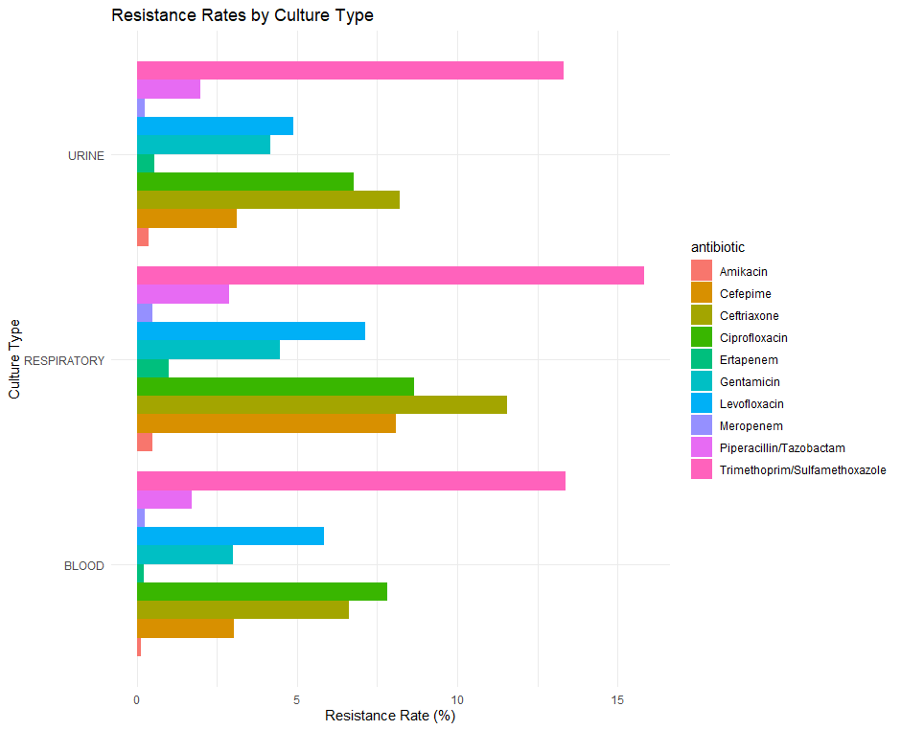
Distribution of resistance rate for Klebsiella Pneumoniae according to Culture type

Slide 11
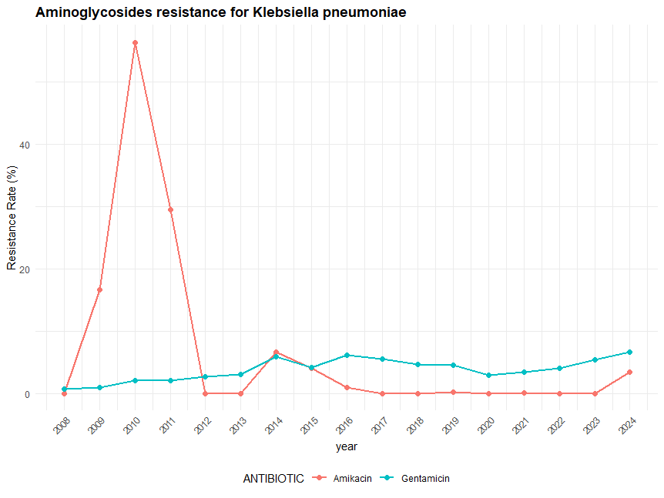
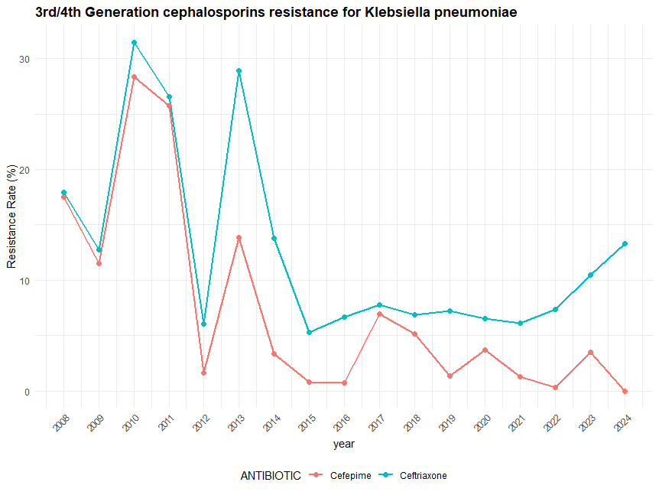
Antibiotic Resistance according to classes
1. Aminoglycosides
2. 3rd/4th Generation Cephaosporines

Slide 12
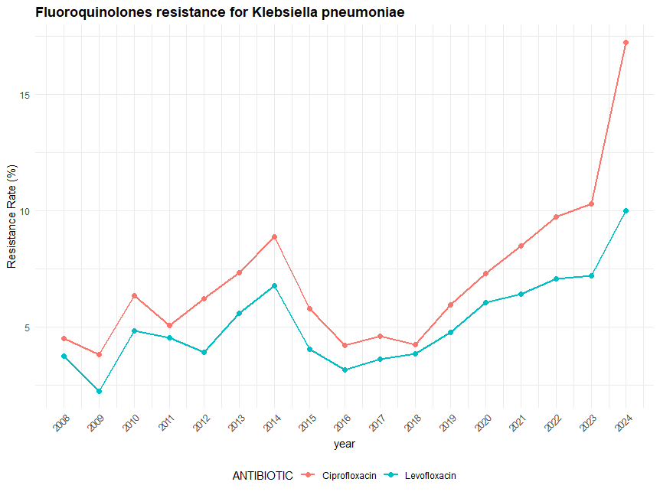
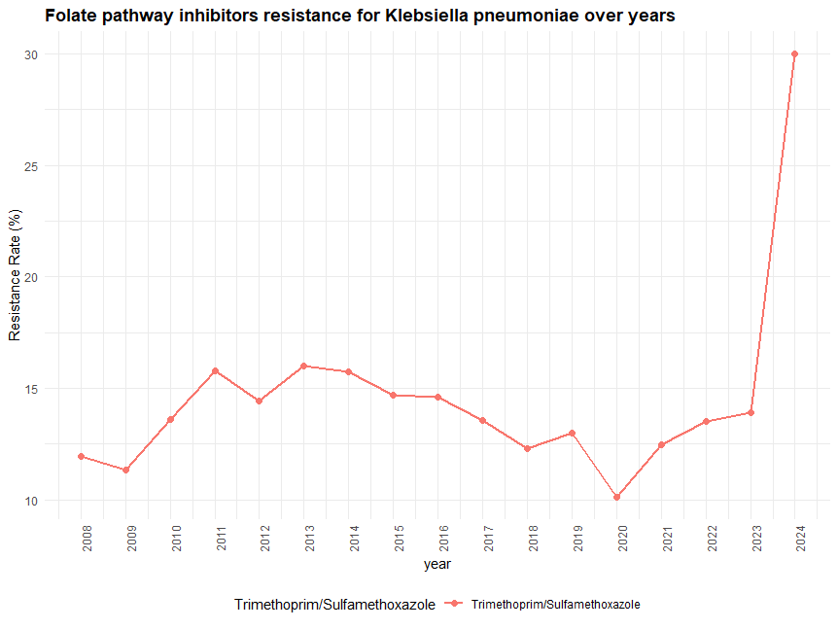
3.fluoroquinolones
4. Folate pathway inhibitors

Slide 13
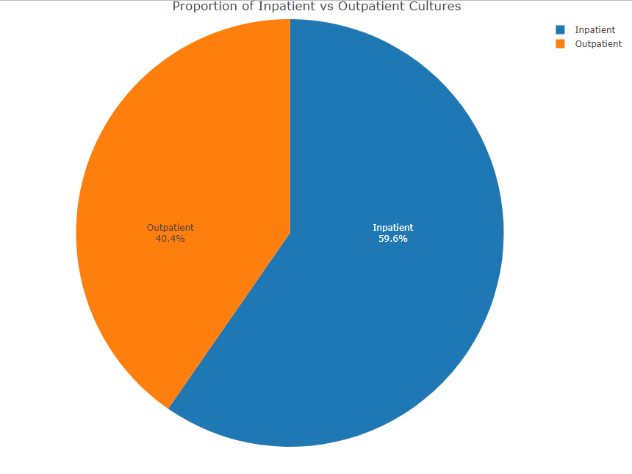
Illustration of the proportion of inpatient vs outpatient cultures and the correlation between k.pneumoniae and nosocomial Infection

Slide 14
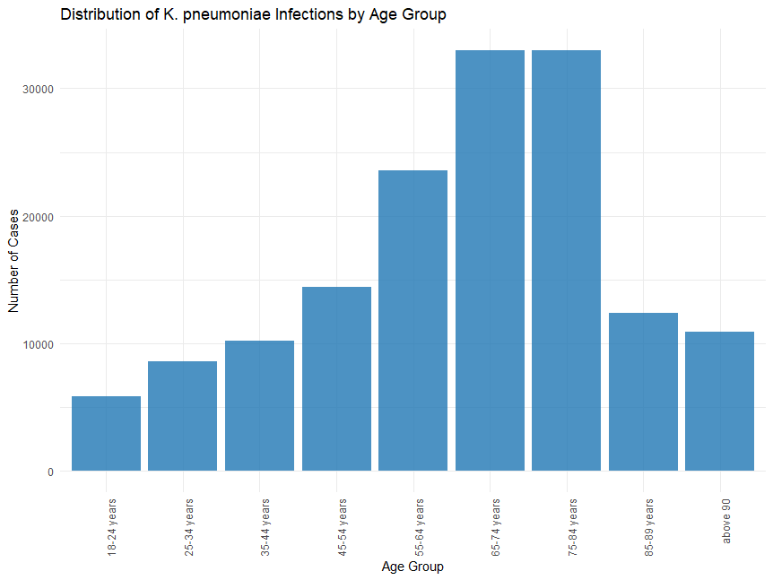
Visualizing the relationship between age and Klebsiella pneumoniae infection
These observations may reflect differences in the selected populations studied. It is not surprising that advanced age was associated with an increased risk because this has been a fairly consistent observation across many previous studies and may be reflective of an age-associated increased risk in general for the comorbid illnesses highly associated with increased risk.

Slide 15
Key Message
This project showed that the overall antibiotic resistance rate of Klebsiella pneumoniae increased significantly compared to 10 years previously.
- Broad-spectrum antibiotics are more commonly used for empirical treatment of both community-acquired and healthcare-associated infections compared to 10 years ago.
- Unnecessary use of broad-spectrum antibiotics can be reduced if K. pneumoniae bacteremia is suspicious and there are no healthcare risk factors, because antibiotic resistance in community-acquired K. pneumoniae bacteremia was not increased.

Slide 16
References
1.Nateghi Haredasht, Fateme; Amrollahi, Fatemeh; Maddali, Manoj et al. (2025). Antibiotic Resistance Microbiology Dataset (ARMD): A de-identified resource for studying antimicrobial resistance using electronic health records [Dataset]. Dryad. https://doi.org/10.5061/dryad.jq2bvq8kp
2.Antibiotic resistance; MacGowan, Alasdair et al.Medicine, Volume 45, Issue 10, 622 – 628
3.Effah, C.Y., Sun, T., Liu, S. et al. Klebsiella pneumoniae: an increasing threat to public health. Ann Clin Microbiol Antimicrob 19, 1 (2020).https://doi.org/10.1186/s12941-019-0343-8
4.Miri Hyun, Chang In Noh, Seong Yeol Ryu, Hyun Ah Kim. Changing trends in clinical characteristics and antibiotic susceptibility of Klebsiella pneumoniae bacteremia.(2018 ) :https://doi.org/10.3904/kjim.2015.257
5.Shiri Navon-Venezia, Kira Kondratyeva, Alessandra Carattoli, Klebsiella pneumoniae: a major worldwide source and shuttle for antibiotic resistance, FEMS Microbiology Reviews, Volume 41, Issue 3, May 2017, Pages 252–275, https://doi.org/10.1093/femsre/fux013

Slide 17
Thank you
reem.emeghalawy.vet@gmail.com
https://github.com/meghalawy/R-EGcompBio-/blob/main/K.P%20project

